Slide 1
Cloud-Based Survey Data Analytics
Azure Cloud Platform Implementation
Project Team:
Guided By : B Prathusha
K Vignesh Reddy – 2320090038
Kiran – 2320090062
M Mahender reddy-2320090065

Slide 2
Project Overview
Cloud-based analytics platform for survey data processing
Fully integrated Azure ecosystem for data pipeline
Real-time analytics and visualization with Power BI
Scalable architecture supporting large survey datasets

Slide 3
Problem Statement
Manual survey data processing is time-consuming
Lack of centralized data storage and accessibility
No real-time insights from survey responses
Limited scalability for growing data volumes

Slide 4
Solution Architecture
Data Ingestion
Azure Blob Storage
ETL Pipeline
Azure Data Factory
Data Warehouse
Azure SQL Database
Analytics
Microsoft Power BI

Slide 5
Azure Components
Resource Group: survey-analytics-rg (Southeast Asia)
Storage Account: surveydatasea2026 (Blob Storage)
SQL Server: survey-analytics-server
SQL Database: free-sql-db-4219034
Data Factory: surveyanalyticsdf

Slide 6
Data Flow: Ingestion & Processing
Step 1: Upload employee_survey.csv to Azure Blob Storage
Step 2: Data Factory reads from Blob container
Step 3: Transformation activities clean and normalize data
Step 4: Load processed data into SQL Database tables

Slide 7
Power BI Integration
Connect Power BI to Azure SQL Database
Real-time dashboard creation for survey insights
Key metrics: Response rates, sentiment analysis, trends
Interactive visualizations for stakeholder reporting

Slide 8
Key Features & Benefits
Automated data processing reduces manual effort by 80%
Scalable cloud infrastructure handles unlimited data growth
Real-time analytics for immediate business insights
Cost-effective with Azure Free Tier benefits

Slide 9
Technical Specifications
Region: Southeast Asia (Low latency, data residency)
Storage: Geo-redundant with read-access replication
Database: Serverless SQL with auto-scaling
Authentication: Microsoft Entra ID (Azure AD)

Slide 10
Security & Compliance
End-to-end encryption for data in transit and at rest
Azure SQL Firewall protects database from unauthorized access
Role-based access control (RBAC) for user permissions
Audit logging for compliance and data governance

Slide 11
Implementation Timeline
Phase 1: Infrastructure setup (Completed)
Phase 2: Data Factory ETL pipeline configuration
Phase 3: Power BI dashboard development
Phase 4: Testing, optimization, and deployment

Slide 12
Dataset Information
File Name
employee_survey.csv
File Size
302.98 KiB
Location
Azure Blob Storage
Status
Uploaded ✓

Slide 13
Power BI Connection Details
Server: survey-analytics-server.database.windows.net
Database: free-sql-db-4219034
Auth Method: Microsoft Entra ID
Account: 2320090038@klh.edu.in

Slide 14
Expected Dashboard Metrics
Total survey responses and completion rate
Department-wise response distribution
Satisfaction scores and trends over time
Top concerns and feedback categories

Slide 15
Future Enhancements
Machine Learning for sentiment analysis automation
Advanced predictive analytics for employee insights
Integration with HR systems for automated data sync
Mobile Power BI app for on-the-go analytics

Slide 16
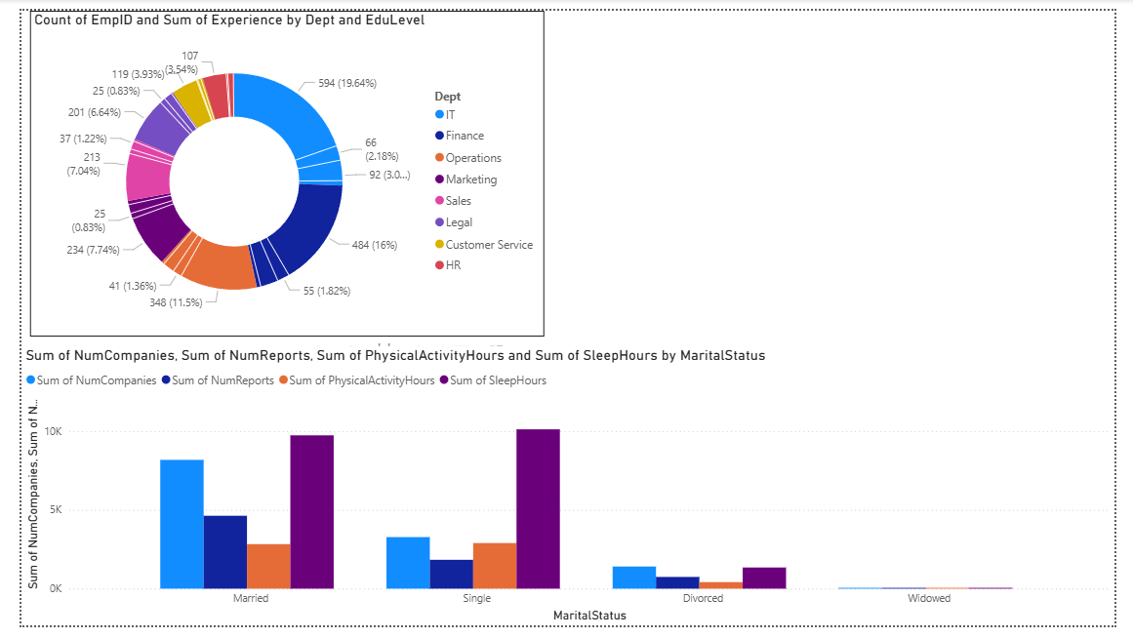

Slide 17
Thank You!

